Slide 1
SolarVision AI FreeTEAM
Han Xu
Shen Shiyu

Slide 2
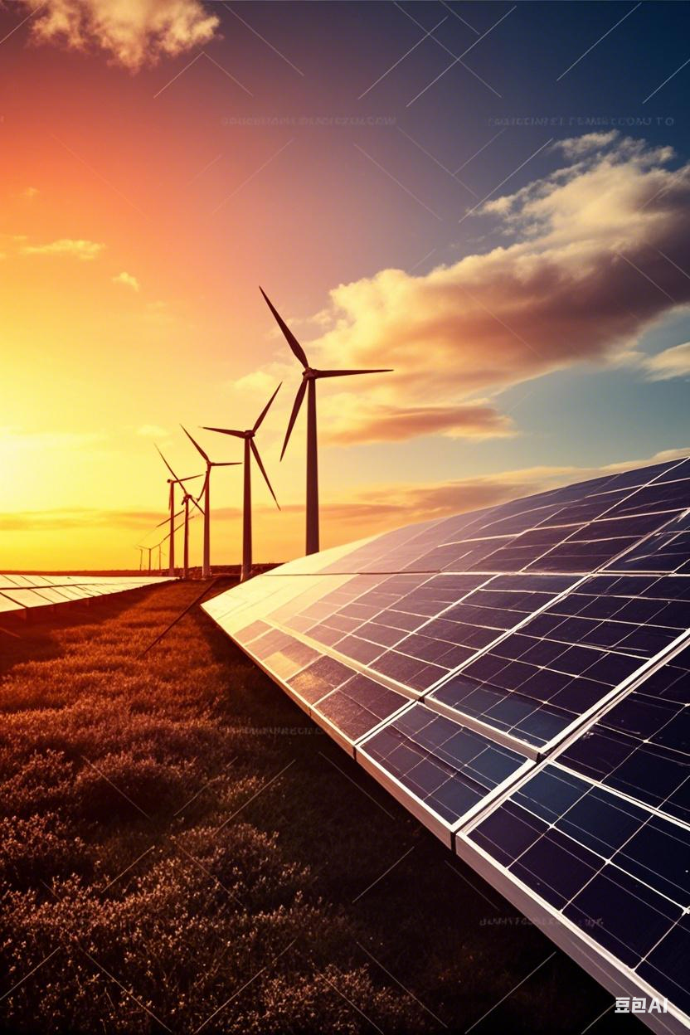
40% solar energy waste due to unpredictable generation
Goal: Build real-time prediction model
Notes:
Teams are recommended to be as much descriptive as possible and highlight the methodology clearly.
Teams are recommended to expand on this topic and use as many slides as you prefer.

Slide 3
Dataset
Data Sources: Used hackathon - provided time series and image data, with some test scenario data for training and validation.
Preprocessing:
Weather Data: Decomposed azimuth angle, combined wind speed/direction, created & decomposed time features.
Image Data: Resized images to 40x40 pixels, saved as numpy arrays with metadata.
Weather Data: Identified outliers, removed night - time records, filled negative values.
Image Data: Forward - filled image paths (max 30 min), looked back for missing images.
Size and Split: Resampled at 10 - min intervals. Training set had 366 days of original training data + 40% test scenario data; rest split for validation and test.
Notes:
Teams are recommended to be as much descriptive as possible and highlight the methodology clearly.
Teams are recommended to expand on this topic and use as many slides as you prefer.

Slide 4
Feature Set: Consisted of weather time series, image data, and aggregate features; target was 12 irradiance values. Architecture: Hierarchical. LSTM processed weather data, CNN processed image data; outputs were concatenated with aggregate features for prediction. Training and Tuning: Boosted high - std irradiance records, used weighted MAE, Adamax optimizer with learning rate reduction, and early stopping.
Model Details

Slide 5
Performance Results
Metric | loss
Training | 120.012
Validation | 117.898
Test | 121.447
CPU times: user 43.1 s, sys: 11.7 s, total: 54.8
Wall time: 24.6 s
Notes:
Teams are recommended to be as much descriptive as possible and highlight the methodology clearly.
Teams are recommended to expand on this topic and use as many slides as you prefer.

